Slide 1
Social Media Marketing Proposal

Slide 2
Social Media
Overview
Strategy on Point.
High SEO Score
Large Social Media Following
Backlinking and Domain Authority
National Media Buy
Followers
34k
30.5k
40k
133k
21k
Instagram
Twitter
Facebook
Linkedin
Youtube
Avg. Engagement
95
6
24
40
4

Slide 3
Social Media Goals - 2023
01
Increase engagement.
02
Positive brand awareness.
03
Increase reach, followers and social shares.
04
Directing more traffic for Domain Authority and lead generation.
05
Increasing social media content generation and community engagement.

Slide 4
Target audience
01
Primary Target Group : Students (age 16-20), students enrolled in colleges, teachers.
02
Secondary Target Group : Parents, working professionals (interested in higher education or shift in career), researchers.
03
Tertiary Target Group : Companies, incubators and potential recruiters.

Slide 5
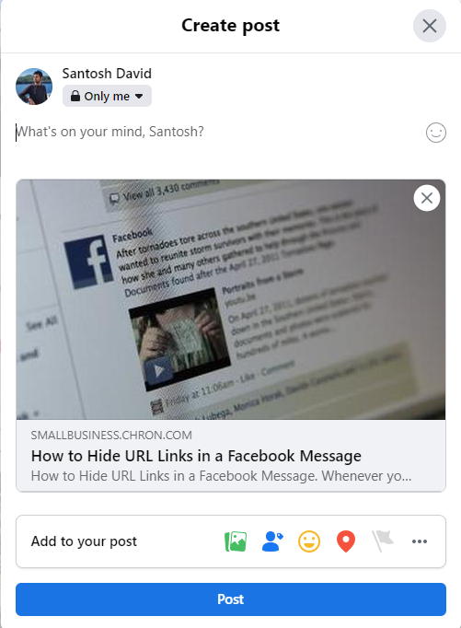
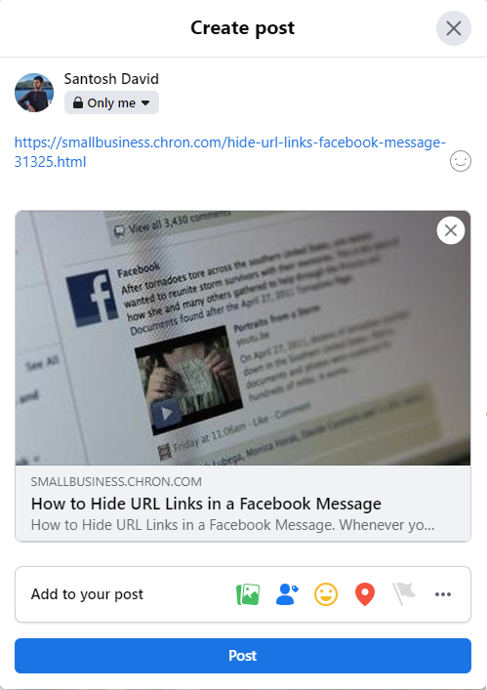
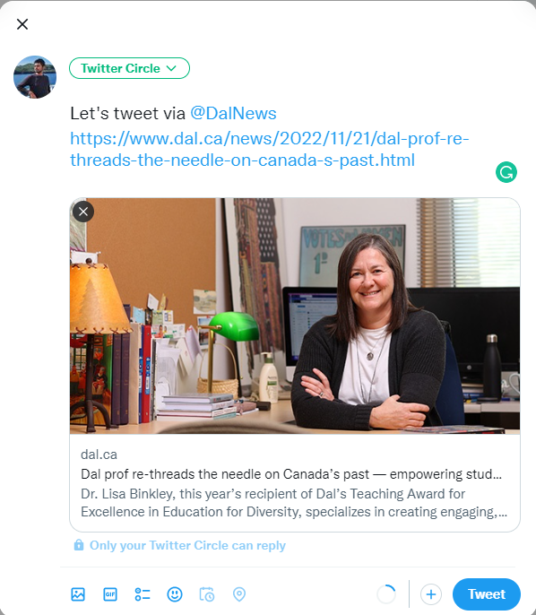
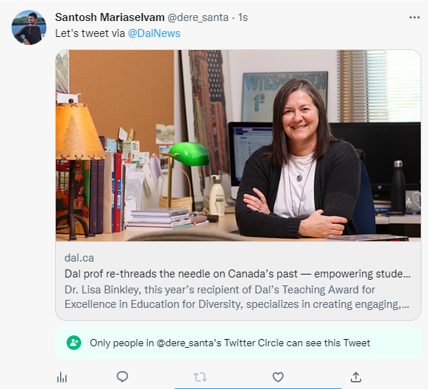
Hyperlinking
Avoiding Bit.ly links (costing credibility).
Facebook
Too many links on page.
Twitter

Slide 6
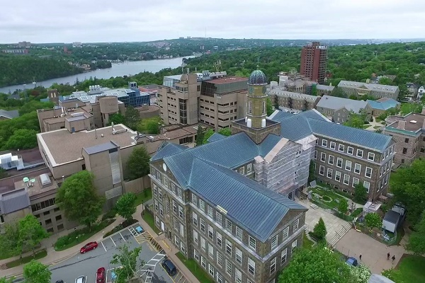
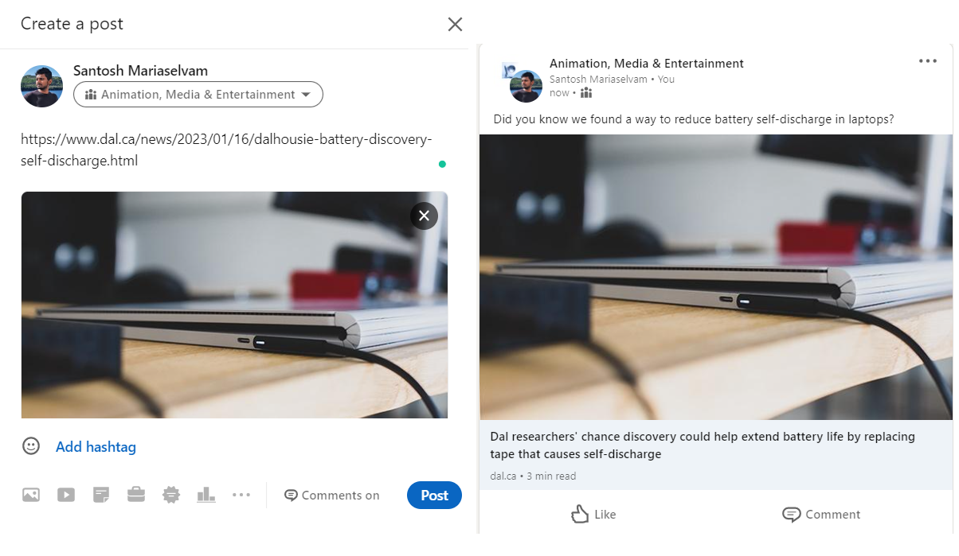
Hyperlinking
Can improve aesthetic and promote engagement.
Linkedin

Slide 7
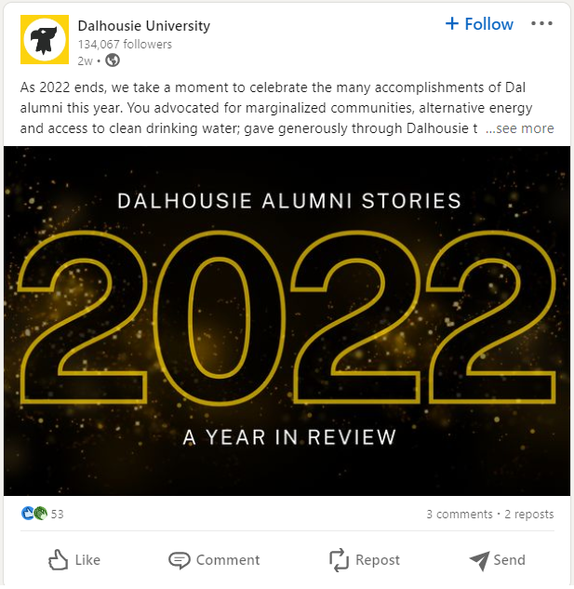
Hyperlinking
Example of invisible hyperlink in posts
Linkedin

Slide 8
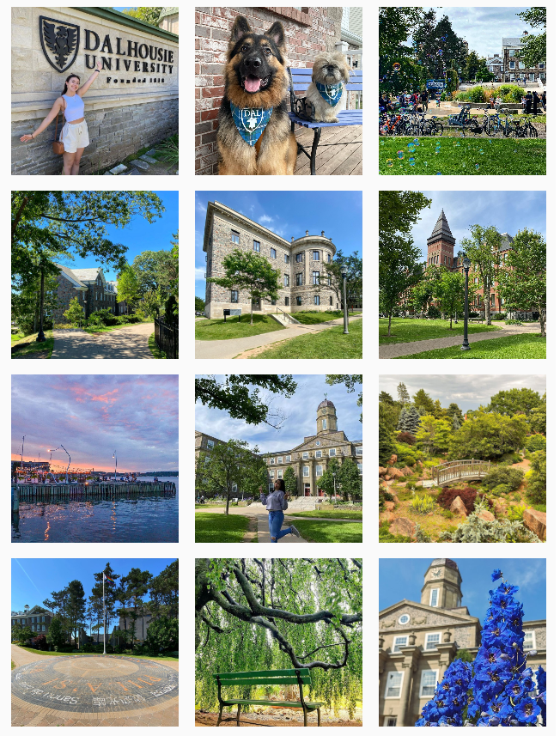
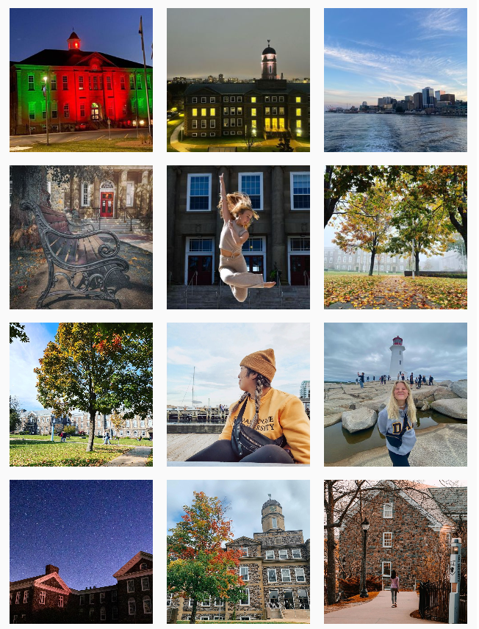
Engagement
18 out of last 24 posts were just buildings.
Instagram

Slide 9
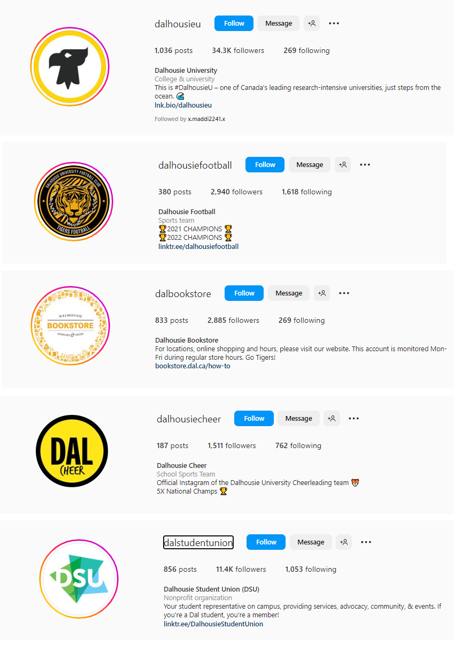
Engagement
Multiple pages chip away engagement. ‘Repost’ strategy!
Multiple Instagram pages chip away at the target group and segregate the interactions
with Dalu. For example Dalstudentlife has more engagement with the Dal community
than the Dalhousieu page on Instagram.
Instagram

Slide 10
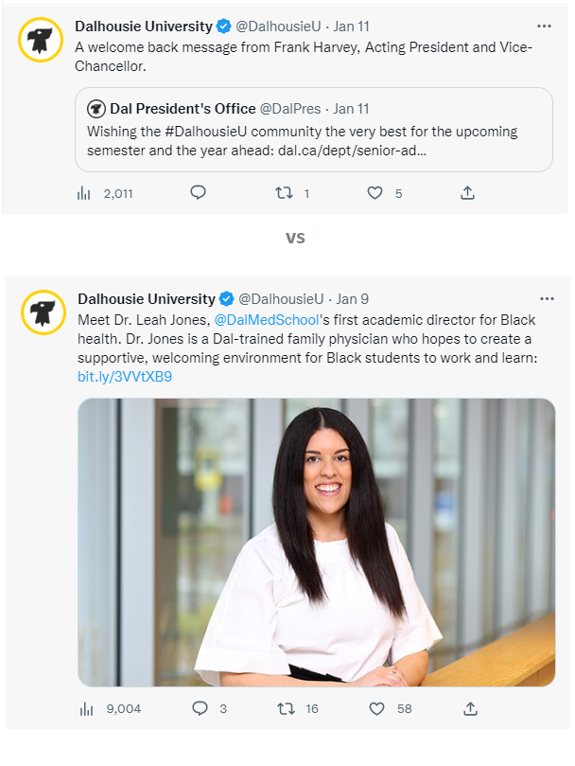
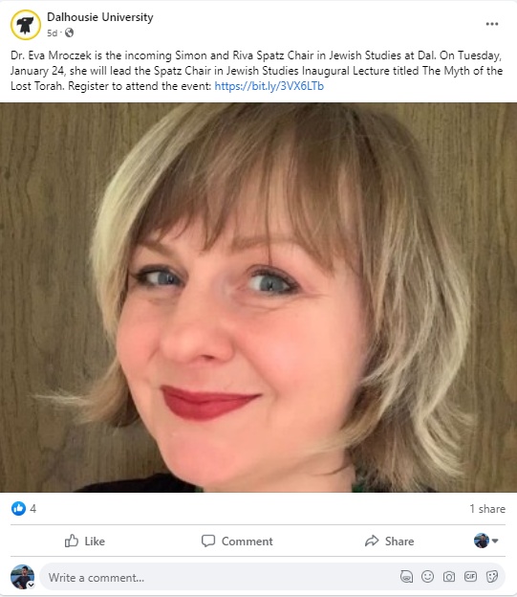
Engagement
Linkedin
Facebook
Zoomed in pictures with very specific captions can be segregating.
Example of post with relevant picture, link and story.

Slide 11
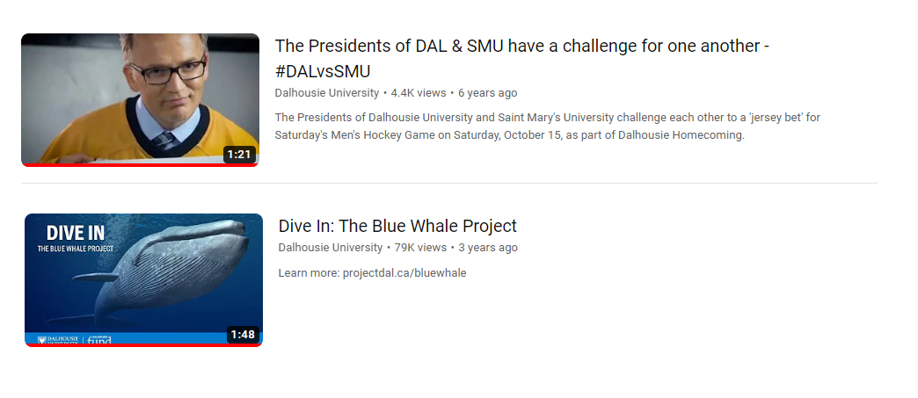
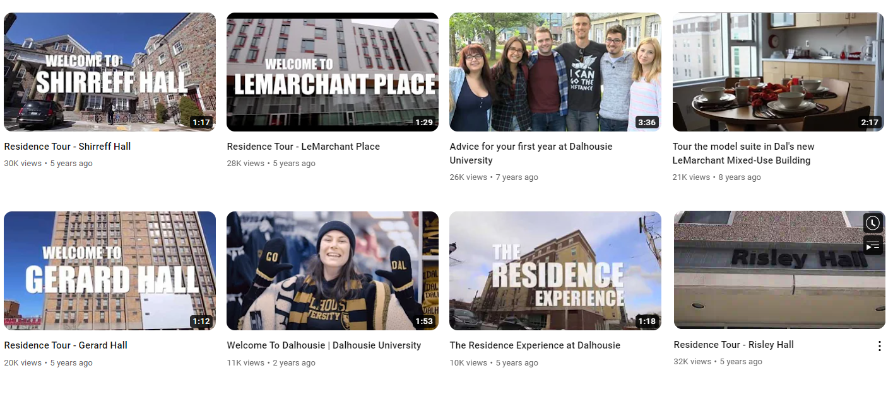
Engagement
Most engaging Youtube campaigns and views are from at least 4 years ago.
Youtube

Slide 12
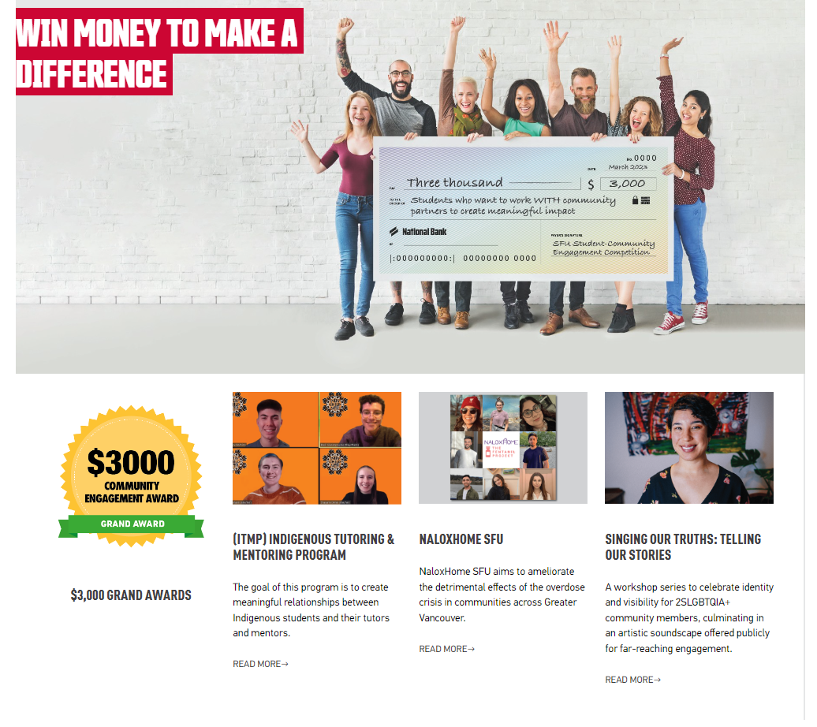
Engagement
Social media contests and fun events that foster community engagement.
Example of Contests highlight by Simon Fraser University

Slide 13
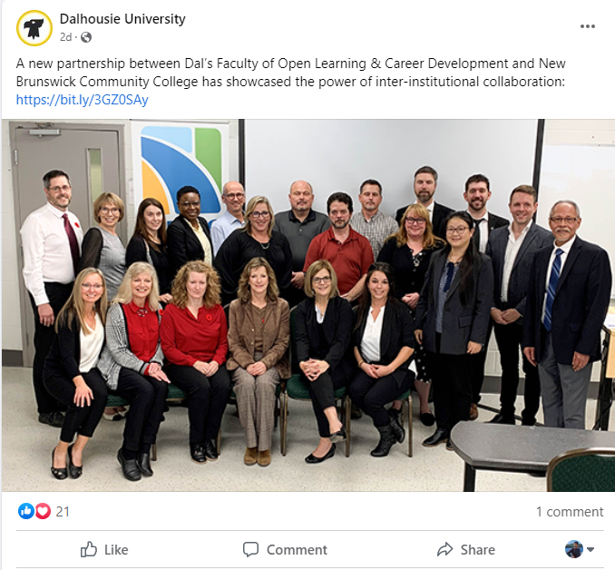
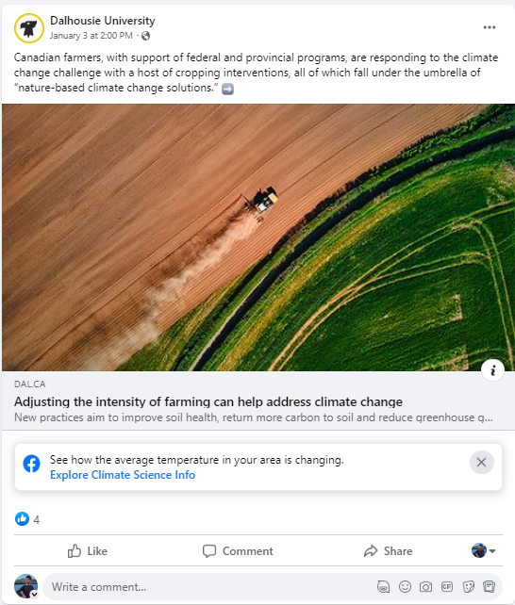
Relevance
Choosing posts based on relevant network and target group.
Facebook

Slide 14
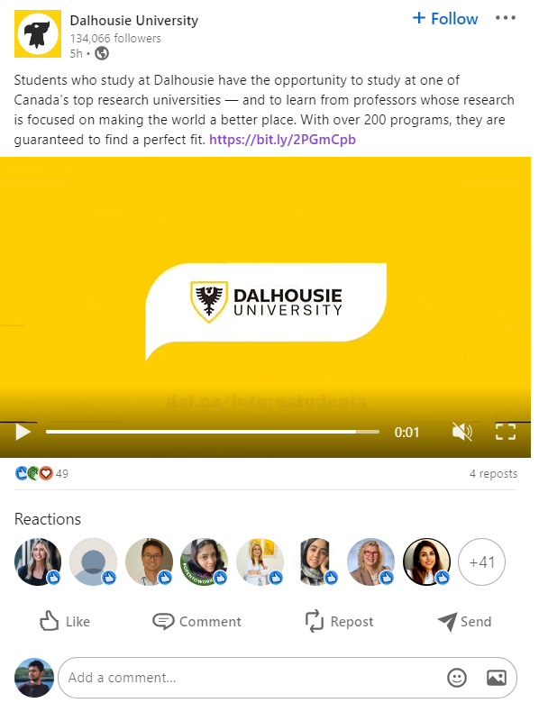
Relevance
Primary Target
Facebook, Twitter and Instagram,
Should also be posted on relevant networks to maximise reach intended target group.
Linkedin

Slide 15
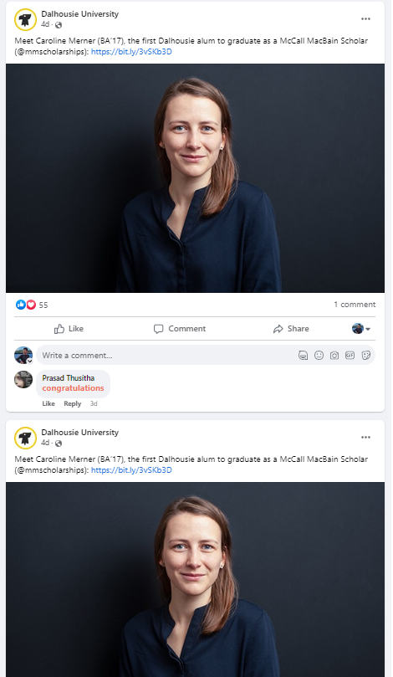
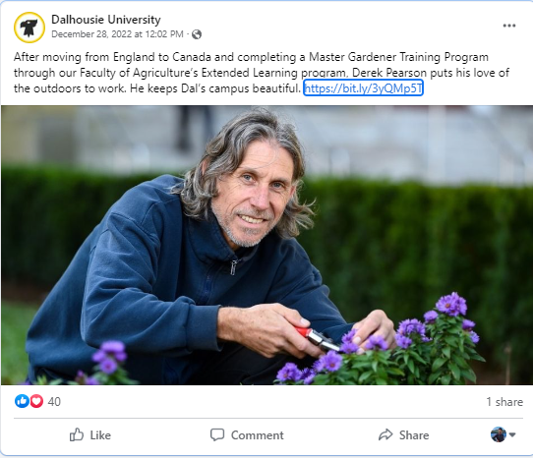
Relevance
Reducing irrelevant backlinks and duplicate posts.
Facebook

Slide 16
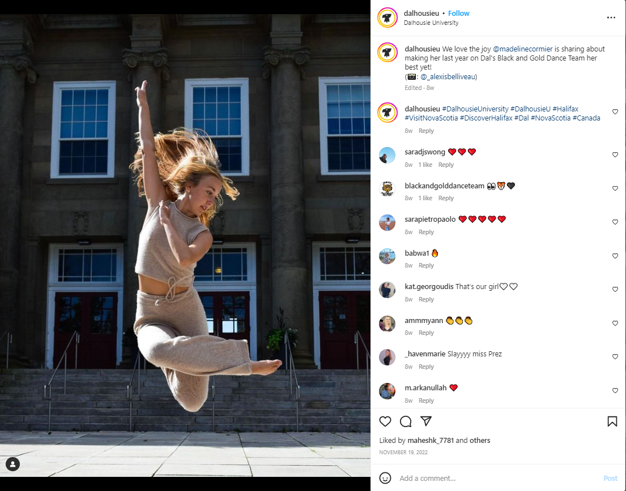
Reach
Hashtags are very generic and repetitive.
Instagram
Hashtags and mentions should be chosen based on relevance, opportunity, engagement, and tracking of specific campaigns.
Hashtags like #BLACKANDGOLD #DANCE #Dalugrad #Gradutiongoggles #Dalcelebrates etc. would have been more relevant and targeted a wider audience.

Slide 17
Reach
Hashtags can also be very aesthetically pleasing and showcase relevance to posts.
Linkedin

Slide 18
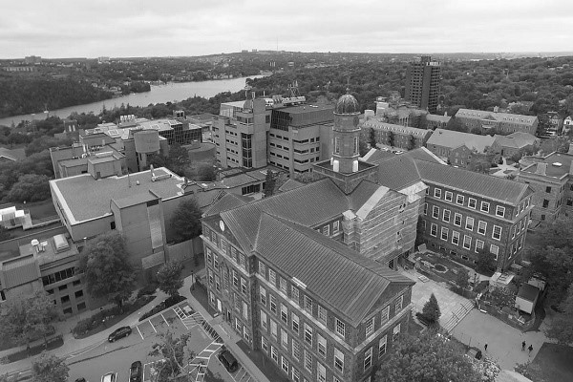
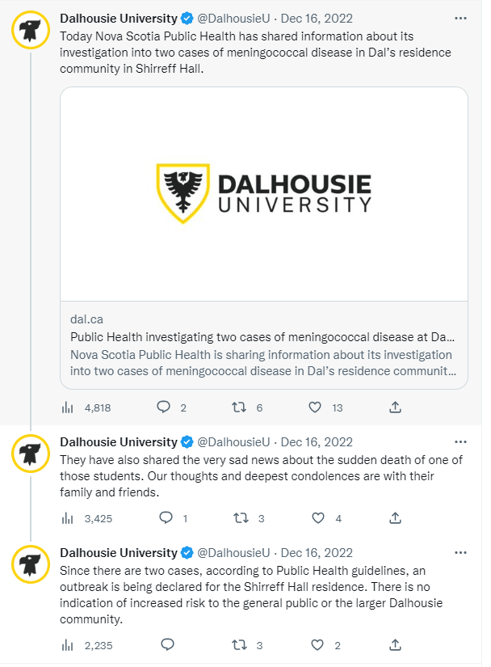
Reach
Lack of Human tone to some important posts.
A good strategy : Talk about it
and give students a forum to express the loss.
A tribute organized by students with
school representation is a good way to show Dalhousie cares about every student.
Linkedin

Slide 19
Competitive Analysis

